Slide 1
Project planning in Sap PS
A comprehensive overview

Slide 2
Introduction
Project planning in SAP Project System (PS) refers to the process of organizing and managing all the activities, resources, and timelines required for a successful SAP implementation.
It involves setting clear objectives, defining tasks, estimating effort, and creating a roadmap to achieve project goals.

Slide 3
IMPORTANCE of effective Project Planning
Efficient Resource Allocation
Timely Delivery
Risk Mitigation
Cost Control
Stakeholder Alignment
Quality Assurance
Adaptability
Notes:
Importance of Effective Project Planning for SAP Implementations:
Efficient Resource Allocation: Proper planning ensures that the right resources are allocated to each task, maximizing productivity.
Timely Delivery: Effective planning helps in setting realistic timelines and milestones, ensuring the project is completed on time.
Risk Mitigation: Identifying potential risks and planning for contingencies reduces the chances of project delays or failures.
Cost Control: Planning allows for better cost estimation and control, preventing budget overruns.
Stakeholder Alignment: Clear project plans foster alignment and communication among team members and stakeholders.
Quality Assurance: Planning helps in defining quality standards and ensures adherence to them throughout the project.
Adaptability: A well-planned project can adapt to changing requirements and priorities more effectively.

Slide 4
Key Benefits of Project Planning
Improved Project Efficiency
Resource Optimization
Streamlined processes and minimized delays.
Proper resource allocation, cost savings.
Clear Milestones and Deliverables
Risk Identification and Mitigation
Track progress and ensure objectives are met
Early detection and mitigation
Notes:
Improved Project Efficiency:
Minimized delays and bottlenecks through effective task scheduling and coordination.
Avoids redundant efforts and ensures productive use of resources.
Resource Optimization:
Proper allocation of resources based on project needs and priorities.
Avoids resource conflicts and overutilization, reducing burnout and enhancing productivity.
Clear Milestones and Deliverables:
Well-established deliverables ensure project objectives are met as planned.
Facilitates effective communication with stakeholders and clients.
Risk Identification and Mitigation:
Early identification of potential risks and challenges.
Minimizes the impact of unforeseen events and keeps the project on track

Slide 5
SAP Project Planning Process
PROJECT INITIATION IN SAP
Defining Project Objectives and Scope
Identifying Project Stakeholders and Team Members
Project Planning in SAP PS
Creating Work Breakdown Structure (WBS)
Developing Project Schedule (Gantt Chart) with SAP PS
Allocating Resources Using SAP PS
Project Execution and Monitoring in SAP
Communicating the Plan Using SAP PS
Monitoring Project Progress and Performance
Project Control and Risk Management in SAP
Tracking Project Status in SAP PS
Identifying and Mitigating Risks with SAP PS
Project Closure in SAP
Evaluating Project Success with SAP PS
Documenting Lessons Learned in SAP PS
Notes:
Slide 5: SAP Project Planning Process
Project Initiation in SAP:
Define Project Objectives and Scope: Clearly outline the goals and boundaries of the SAP project, ensuring alignment with the organization's strategic objectives.
Identify Project Stakeholders and Team Members: Identify key stakeholders and assemble a competent project team with the necessary skills and expertise.
Project Planning in SAP PS:
Create Work Breakdown Structure (WBS): Hierarchically divide the project into manageable tasks and sub-tasks, facilitating better organization and control.
Develop Project Schedule (Gantt Chart) with SAP PS: Create a visual representation of project timelines, milestones, and dependencies using SAP PS Gantt charts.
Allocate Resources Using SAP PS: Efficiently assign resources to each task, optimizing workforce allocation and avoiding bottlenecks.
Project Execution and Monitoring in SAP:
Communicate the Plan Using SAP PS: Share the project plan with all stakeholders to ensure a shared understanding of expectations and responsibilities.
Monitor Project Progress and Performance: Continuously track the project's actual progress against the planned schedule, identifying any deviations and taking corrective actions as needed.
Project Control and Risk Management in SAP:
Track Project Status in SAP PS: Utilize SAP PS to monitor real-time project status, task completion, and resource utilization.
Identify and Mitigate Risks with SAP PS: Proactively identify potential risks using SAP PS tools and implement risk mitigation strategies to prevent disruptions.
Project Closure in SAP:
Evaluate Project Success with SAP PS: Assess whether the project objectives were met and evaluate the overall success using SAP PS data and metrics.
Document Lessons Learned in SAP PS: Capture valuable insights and best practices from the project, facilitating continuous improvement for future endeavors.

Slide 6
sAP PS Work Breakdown Structure (WBS)
The Work Breakdown Structure (WBS) in SAP PS is a hierarchical tool that breaks down complex projects into manageable components. It provides a structured view of project scope, tasks, and deliverables.
Key points:
Hierarchical Structure: Top-down breakdown into work packages and tasks.
Unique Identification: Each element has a unique code for easy tracking.
Scope Definition: Clearly defines project scope and components.
Task Assignment: Facilitates task allocation and resource management.
Control and Monitoring: Helps track progress and manage risks.
Cost and Time Estimation: Aids in estimating project costs and timelines.
Communication Tool: Visual way to communicate project structure.
SAP PS WBS enhances project planning, execution, and collaboration, leading to successful project outcomes.
Notes:
Explanation of WBS in SAP PS:
The Work Breakdown Structure (WBS) in SAP PS is a fundamental project management tool used to divide complex projects into smaller, manageable components. It represents the hierarchical breakdown of the project's scope, deliverables, and tasks, providing a structured view of the project's work to be accomplished. Each level of the WBS further decomposes the project into more detailed and specific elements, allowing for better planning, coordination, and control of project activities.
Key points about the WBS in SAP PS:
Hierarchical Structure: The WBS follows a top-down approach, starting with the project's main deliverable, often referred to as the project phase or level 1. Each subsequent level breaks down the project into smaller work packages, tasks, and sub-tasks.
Unique Identification: Each WBS element is assigned a unique code, making it easy to reference and track specific components within the project.
Scope Definition: The WBS helps in defining the project's scope clearly, ensuring that all project components are accounted for and nothing is overlooked.
Task Assignment: The WBS facilitates the assignment of tasks to team members, enabling efficient resource allocation and accountability.
Control and Monitoring: The WBS provides a basis for project control and progress monitoring. It helps track the completion of tasks, identify bottlenecks, and manage project risks.
Cost and Time Estimation: By breaking down the project into smaller elements, the WBS aids in estimating costs and timelines more accurately.
Communication Tool: The WBS serves as a visual communication tool, enabling stakeholders to understand the project's structure and components easily.
Overall, the WBS in SAP PS plays a crucial role in project planning, execution, and successful delivery by organizing complex projects into manageable pieces, enhancing team collaboration, and fostering effective project management.

Slide 7
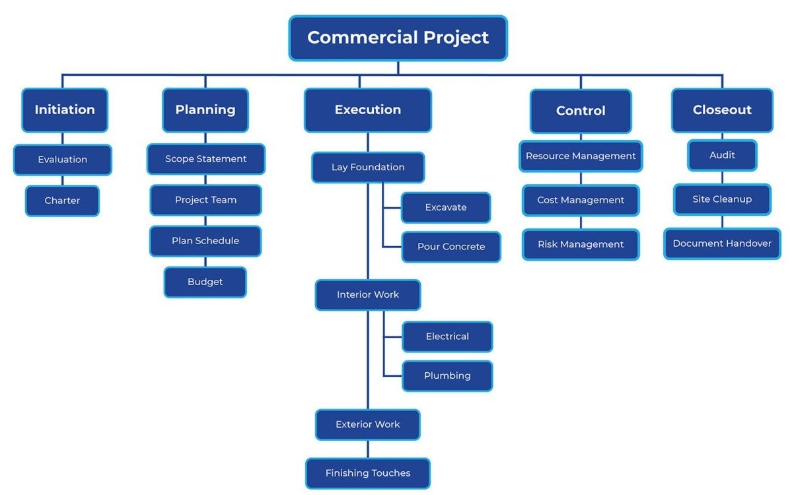
WORK BREAKDOWN STRUCTURE

Slide 8
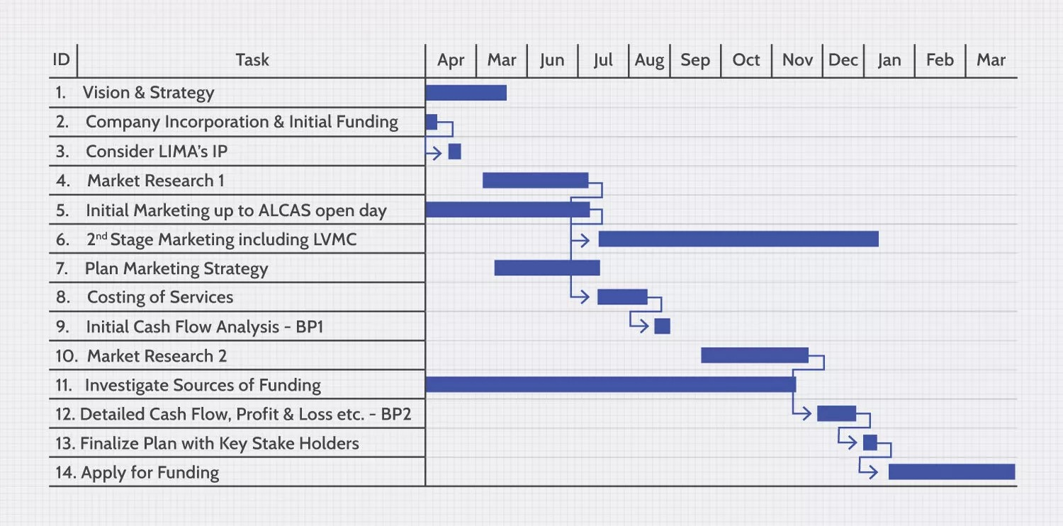
Gantt Chart
Gantt charts are essential project management tools in SAP PS that visually illustrate project schedules and task dependencies.
Benefits:
Visual Clarity
Task Scheduling
Resource Management
Progress Tracking
Risk Identification
Communication Tool
Notes:
The Gantt chart in SAP PS offers numerous benefits for effective project management:
Visual Clarity: Project managers and stakeholders can easily grasp project timelines, milestones, and critical paths.
Task Scheduling: Optimized task sequencing helps minimize project duration and potential delays.
Resource Management: Gantt charts aid in resource allocation and balancing workloads.
Progress Tracking: Real-time updates enable tracking of task completion and project progress.
Risk Identification: Potential bottlenecks and conflicts can be detected, allowing timely interventions.
Communication Tool: Gantt charts facilitate communication and coordination among team members and stakeholders.
HOW TO READ A GANTT CHART
Tasks are displayed along the y-axis, and the x-axis represents the project's timeline, usually in weeks or months.
Tasks are represented as horizontal bars on the chart, with the length of each bar corresponding to the task's duration.
Dependencies between tasks are shown through connecting lines, ensuring a coherent view of the project's workflow.

Slide 9
Resource Allocation
Importance of Resource Planning in SAP PS:
Ensures tasks are adequately staffed and completed on time.
Optimizes resource utilization and enhances project productivity.
Utilizing SAP PS for Efficient Resource Allocation:
Resource leveling prevents over/underutilization.
Resource histograms identify bottlenecks.
Capacity planning analyzes resource demand.
Resource substitution ensures schedule adherence.
Notes:
Slide 8: SAP PS Resource Allocation
Importance of Resource Planning in SAP PS:
Efficient resource allocation is crucial in SAP PS to ensure that tasks are appropriately staffed and completed within the planned schedule.
Proper resource planning minimizes the risk of project delays and enhances overall project productivity and success.
By aligning resources with project requirements, organizations can optimize their workforce utilization and achieve cost-effectiveness.
Utilizing SAP PS for Efficient Resource Allocation:
SAP PS provides robust features to optimize resource allocation and prevent over/underutilization.
Resource leveling: SAP PS can automatically adjust resource assignments to avoid peaks and troughs in workload, maintaining a steady workforce utilization.
Resource histograms: Visual representations in SAP PS show resource availability and help identify potential bottlenecks.
Capacity planning: SAP PS allows organizations to analyze resource capacity against project demand, ensuring that resources are neither overwhelmed nor underused.
Resource substitution: In case of resource unavailability, SAP PS assists in finding suitable alternatives without affecting the project schedule.

Slide 10
Cost estimation and budget allocation
Cost Estimation in SAP PS
Budget Allocation in SAP PS
Integration with SAP Financial Modules
Accurate forecasting of project costs.
Utilizing historical data and project structures for estimation.
Creating cost estimates for activities, resources, and materials.
Allocating funds for various project elements.
Monitoring and controlling budget utilization.
Ensuring cost compliance throughout the project lifecycle.
Seamless integration with SAP Finance and Controlling (FICO).
Real-time financial data exchange between PS and FICO modules.
Enabling better financial planning and reporting.
Notes:
Key Benefits:
Enhanced project cost control.
Improved financial visibility.
Efficient resource allocation.
Streamlined financial reporting.

Slide 11
RISK MANAGEMENT
Identifying and Managing Risks in SAP PS
Using SAP PS for Risk Mitigation Strategies
SAP PS helps in identifying and assessing project risks through comprehensive risk analysis tools.
Risks are identified for each project task, and their potential impact on the project is evaluated.
Early risk detection in SAP PS allows for proactive risk management and contingency planning.
SAP PS supports the implementation of risk mitigation plans to address identified risks effectively.
Mitigation strategies are assigned to specific tasks, ensuring risk handling is integrated into project execution.
SAP PS enables ongoing monitoring of risk factors, providing timely updates on risk status and effectiveness of mitigation efforts.
Notes:
SAP PS enhances risk management practices by proactively identifying and addressing potential threats. Through integrated risk analysis and mitigation capabilities, organizations can mitigate risks efficiently and safeguard project success.

Slide 12
Project Communication
Effective Communication with Stakeholders in SAP PS
Leveraging SAP PS for Project Collaboration
Establishing clear communication channels.
Regular status updates and progress reports.
Engaging stakeholders throughout the project lifecycle.
Utilizing SAP PS for centralized document sharing.
Facilitating real-time collaboration among team members.
Integrating communication tools within SAP PS.

Slide 13
Project Monitoring and control
Real-time Project Monitoring and Control with SAP PS
Taking Corrective Actions using SAP PS Data
SAP PS offers real-time project monitoring, providing up-to-date information on task status, resource utilization, and milestones.
Project managers can access real-time dashboards and reports in SAP PS, ensuring proactive decision-making based on accurate data.
With instant access to project information, potential delays and bottlenecks can be identified early, allowing timely interventions.
SAP PS data serves as a foundation for analyzing project performance and identifying deviations from the planned schedule.
Deviation alerts and reports enable project managers to take immediate corrective actions and mitigate risks.
By leveraging SAP PS data, project managers can optimize resource allocation, adjust schedules, and ensure project success.

Slide 14
Project Closure and lessons learned
Closing Projects in SAP PS
Capturing Lessons Learned for Future Projects
Finalizing Deliverables: Ensure all project deliverables are completed and approved.
Financial Closure: Settle all financial aspects, including budget reconciliation.
Resource Release: Release project resources and reassign them to other tasks.
Documentation: Organize and archive all project documentation for future reference.
Final Review: Conduct a comprehensive review of the project's performance.
Team Feedback: Gather input from project team members on what went well and what could be improved.
Stakeholder Input: Collect feedback from key stakeholders to identify areas for enhancement.
Documentation: Record lessons learned in a structured manner for easy retrieval.
Knowledge Sharing: Promote knowledge sharing across the organization based on insights gained.
Continuous Improvement: Use lessons learned to enhance future project planning and execution.
Notes:
Slide 13: SAP PS Project Closure and Lessons Learned
Closing Projects in SAP PS:
In SAP PS, formal project closure involves completing all project tasks and deliverables.
Project managers review the project's scope, ensuring all objectives are met, and obtain necessary approvals.
Final project documentation is generated, including project reports, financial summaries, and sign-off documents.
Project closure in SAP PS involves archiving project data for future reference and auditing purposes.
Capturing Lessons Learned for Future Projects:
SAP PS enables the documentation of lessons learned from each project.
Project teams and stakeholders share their insights and experiences for continuous improvement.
Lessons learned are recorded in SAP PS, providing a valuable knowledge base for future projects.
Analyzing past projects' successes and challenges helps optimize processes and avoid repeated mistakes.

Slide 15
Conclusion
Importance of Project Planning in SAP
Efficient Resource Allocation: Optimal allocation of resources to tasks and activities.
Time Management: Streamlined scheduling and timely project completion.
Cost Control: Better financial management and budget adherence.
Risk Mitigation: Identification and mitigation of potential risks.
Quality Assurance: Ensuring high-quality project deliverables.
How SAP PS Facilitates Effective Project Planning and Execution
Integrated Platform: All project data in one centralized system for easy access and collaboration.
Project Structuring: Hierarchical breakdown of tasks and work packages.
Resource Management: Efficient allocation and tracking of project resources.
Scheduling Tools: Gantt charts and planning boards for visual project scheduling.
Budgeting and Controlling: Real-time monitoring of project costs and financials.

Slide 16
Thank you

